Slide 1
Unwinding PD Family Hire
PD Mini Training
July 2023
DBHDD PD Team

Slide 2
Public Health Emergency Appendix K
Ended May 11, 2023
The state has 6 months to unwind services that were allowed during PHE/Appendix K
Grace Period ends November 11, 2023
The state must revert to its original waiver policies
NOW/COMP Waiver Family Hire Policies in the Program Manual will be reinstated on November 12, 2023

Slide 3
After November 11, 2023
Legal guardians, waiver participant spouses, and parents of minors are not permitted to be paid caregivers per Chapter 900, section 902, PART II Policies and Procedures COMP and NOW Waiver Program Manual.
Respite will no longer be a service available for Family Hire.

Slide 4
Unwinding details….
Family members who have extenuating circumstances as defined in Chapter 1200 will need to apply no later than July 31, 2023, to continue being paid caregivers after November 11, 2023.
Family Hire applications with supporting documentation must be submitted to participant.direction@dbhdd.ga.gov no later than July 31, 2023.
DBHDD will send out notification of approval or denial no later than September 15, 2023, to the responsible parties

Slide 5
More Details…
Appendix K Family Hire application approvals will be valid from November 12, 2023, through February 28, 2024. The approval letter will list the due date for the next family hire application.
Only family hire applicants approved by DBHDD will be permitted to continue employment with the fiscal agencies after November 11, 2023.

Slide 6
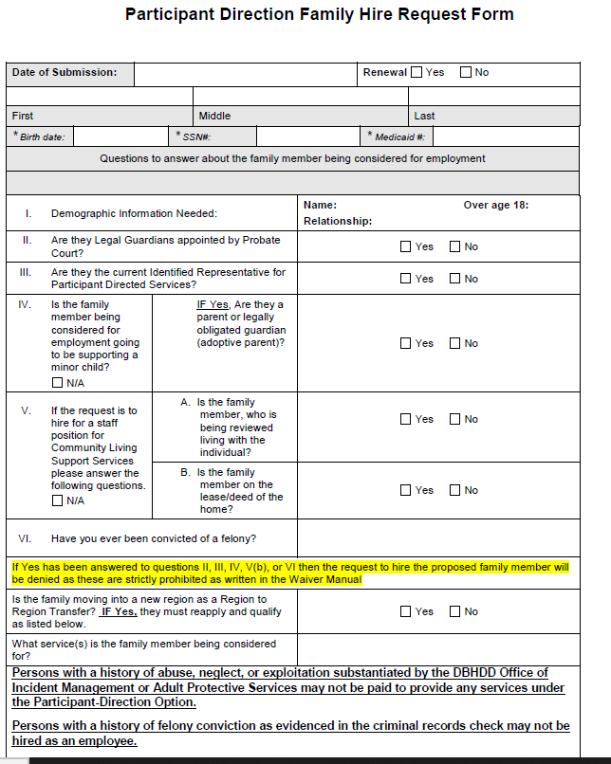
Let’s look at the PD Family Application…page 1
Please fill in and check appropriate boxes
Please that as of July 1, 2023, the family member may be on the lease or deed. We do want you to answer this question, but it will not be considered in the approval decision
All other criteria on this page will be taken into consideration for approval/denial.

Slide 7
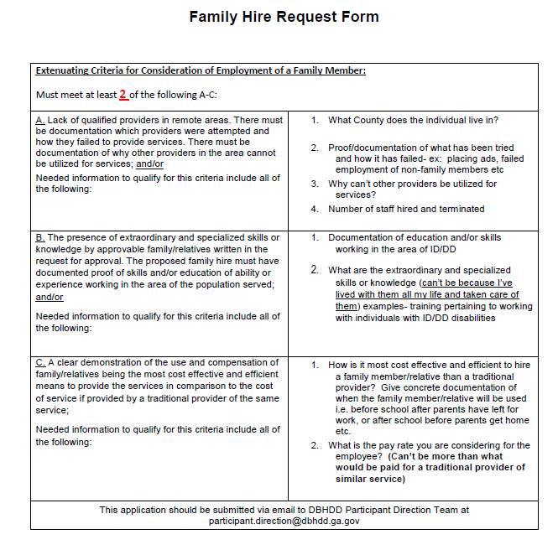
Diving into page 2 of PD Family hire application:
Must meet 2 of A-C to be considered for approval
writing in answers on the second column is not acceptable- you must include these in your cover letter and in any supporting material
If you want to circle or highlight the criteria that you plan to use, that will be helpful for us when we cross reference your letter, supporting materials and the application

Slide 8
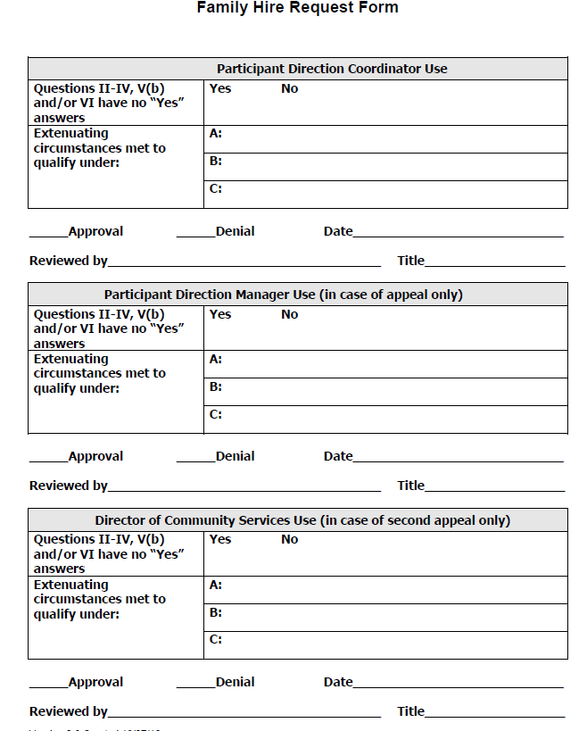
Page 3 of Family Hire
This page should be included with your application, but there is nothing for you to complete.
PD coordinators will use this page to record approval or denial
If an application is denied and appealed, then this page will be used for 2nd or 3rd review

Slide 9
Page 4 of PD Family Hire application…
This page was designed for explanations of items from page 2.
You can cut and paste your cover letter onto this page if you want
You can also leave blank, but attach your cover letter and other flyers or supplemental materials to the end of the application
When submitting, please make sure this page is in the application even if you choose to leave blank and add other documentation.

Slide 10
What is meant by “can’t be more than what would be paid for a traditional provider of similar service”?
This means that the employee is not paid more than the traditional provider rate for the service.
For Community Living Support Services (CLS):
the traditional provider rate for CLS-extended is $6.76/15 minutes, so the max a family caregiver could be paid is $27.04/hour for CLS-extended.
The traditional provider rate for CLS-basic is $7.49, so the max a family caregiver could be paid is $29.96 for CLS-basic.
For Community Access Individual (CAI) and Group (CAG)
the traditional provider rate for CAI is $8.73/15 minutes, so the max family caregiver pay is $34.92/hour for CAI.
The traditional provider rate for CAG is $3.65/15 minute unit so the max family caregiver pay is $14.60/hour for CAG.
Notes:
Rates indicated above are based on the 2% increase as of 7/1/2022.
Service Reimbursement rates are located in :
Appendix A in PART III CHAPTERS 1300 – 3700 POLICIES AND PROCEDURES FOR COMPREHENSIVE SUPPORTS WAIVERS PROGRAM
and
Appendix A in Part PART III CHAPTERS 1300 – 3400 POLICIES AND PROCEDURES FOR NEW OPTIONS WAIVER PROGRAM (NOW)

Slide 11
What is meant by supporting material?
Letter of circumstances including:
An explanation of how you meet the 2 of the 3 criteria on page 2
Be specific and explain what you have done to search for staff and hire staff
Include the family hire relationship and why they are a good fit
Any other information you want to include to make your case for family hire
Flyers w/ date and times and places of posts
Screen shots of advertisements on websites including names of websites and dates posted
Any other information that may help support your case for family hire

Slide 12
A completed Family Hire application consists of …
The full application….all 4 pages
Letter of circumstances
Supporting material that supports your case for family hire
include at least two of the three extenuating circumstances as outlined on page 2 of the application and as defined in Chapter 1200, PART II Policies and Procedures COMP and NOW Waiver Program Manual.

Slide 13
Sending completed application:
Send completed application with supporting material to:
participant.direction@dbhdd.ga.gov
Make sure you copy your Support Coordinator or Planning List Administrator on the email
Enter “Family Hire Request‐ Region #” in the subject line of the email.

